Slide 1


A0100

Slide 2




At the heart of
Power Maths
is the belief that all children can achieve.
It’s built on an exciting growth mindset and
problem-solving approach.
Notes:
Power Maths is an interactive, whole-class teaching model.
It encourages precise mathematical language and allows children to deepen their understanding as far as they can.
By working hard, all children can achieve.

Slide 3

Key aims of Power Maths
Helps children problem-solve by building on prior learning to help them see connections and patterns.
Builds every concept in small, progressive steps to help keep the whole class together.
Teachers check understanding throughout the lesson to ensure all children are keeping up.
Notes:
Builds every concept in small, progressive steps to help keep the whole class together.
Helps children problem-solve by building on prior learning to help them see connections and patterns.
Teachers can check understanding throughout the lesson to ensure all children are keeping up.
Power Maths aims to spark curiosity and encourages rich mathematical talk.

Slide 4

In a nutshell …
An exciting whole-class mastery approach for Reception to Year 6
Written by mastery experts and inspired by best practice from around the world
Fully recommended by the Department for Education
Created specifically for UK classrooms
Makes maths an adventure and helps build a culture of excitement and confidence!
Notes:
Power Maths is aligned with the National Curriculum, and is a whole-class mastery resource to empower every child to understand and succeed in maths.

Slide 5


What is mastery?
“Mastering maths means acquiring a deep, long-term, secure and adaptable understanding of the subject” – NCETM
We achieve this by …
Carefully
sequenced,
small step
learning
A range of representations to build deeper understanding
Developing
mathematical
thinking
Building
fluency

Slide 6
Growth mindset
Fixed mindset
Growth mindset
“I’m not good at maths – I’ve never been good at maths”
“I’m finding maths hard now, but I can improve with time and effort”
“I give up – I can’t make this any better”
“I can improve if I keep trying”
“If I fail I am a failure”
“Most successful people fail along
the way”
“I can’t do this – I keep making mistakes”
“Mistakes help me learn”
Notes:
The growth mindset approach encourages children to see mistakes as learning opportunities. It promotes hard work and practice, and discourages the idea that some people ‘can’t do maths’.

Slide 7
Our lesson structure
Lesson Point | Description
Flashback 4 | To consolidate prior learning
‘Feedback Starter’ | To address misconceptions and recap prior learning before introducing anything new
Teaching input | To link prior learning to new learning Check understanding of vocab in the LI Introduce new content Modelled rehearsal of new skill
Think Together activity | Guided/Independent rehearsal Checking understanding
Independent work | From Practice Book- all to start on the same page 1:1 support or groupwork for any children identified (may have extra fluency practise together first)
Mini-plenary | Check first few answers and address any common misconceptions
Independent work | Continued independent work and challenging reasoning and problem solving extension Marking answers
Plenary | Challenge to review progress made or extend learning Traffic lighting work
After our final lesson: Maths Weekly Reflection | Reflecting on learning this week and how connects to prior and future learning. What they did, how they did it and why they did it
Notes:
A consistent structure for delivering a whole-class mastery approach in which no child is left behind. Each lesson follows the same format, which we will show in the following slides.
Same-day interventions help us keep the class progressing together, so Power Maths provides plenty of support throughout the journey.

Slide 8
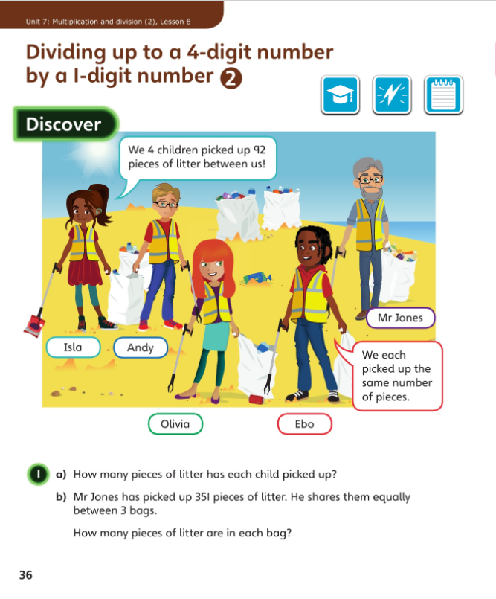
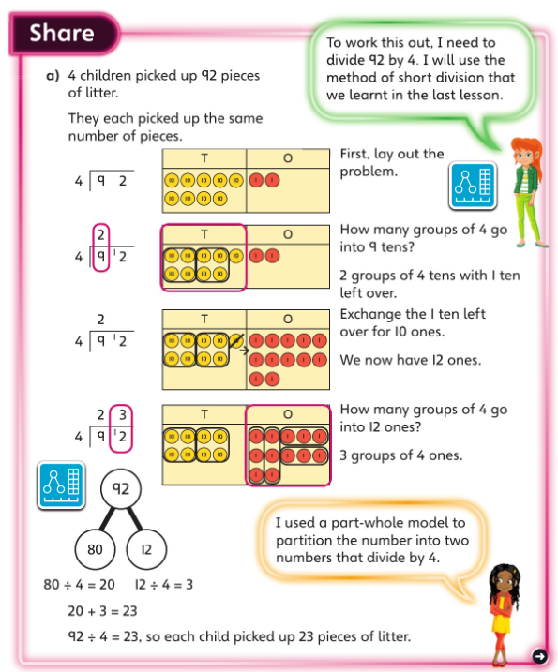
Discover and Share
Concrete-Pictorial-Abstract approach
Engaging scenarios
Notes:
In Discover, appealing real-life scenarios stimulate curiosity, helping children to identify the maths problem and discover patterns and relationships for themselves.
The concept is introduced logically using a Concrete-Pictorial-Abstract approach to help children to make connections and grasp concepts.
Here in Share part a), children are shown the pictorial representation of place value counters alongside the more abstract method of short division. The Power Maths characters provide support and help children to develop a growth mindset by encouraging them to think, reason and reflect.

Slide 9
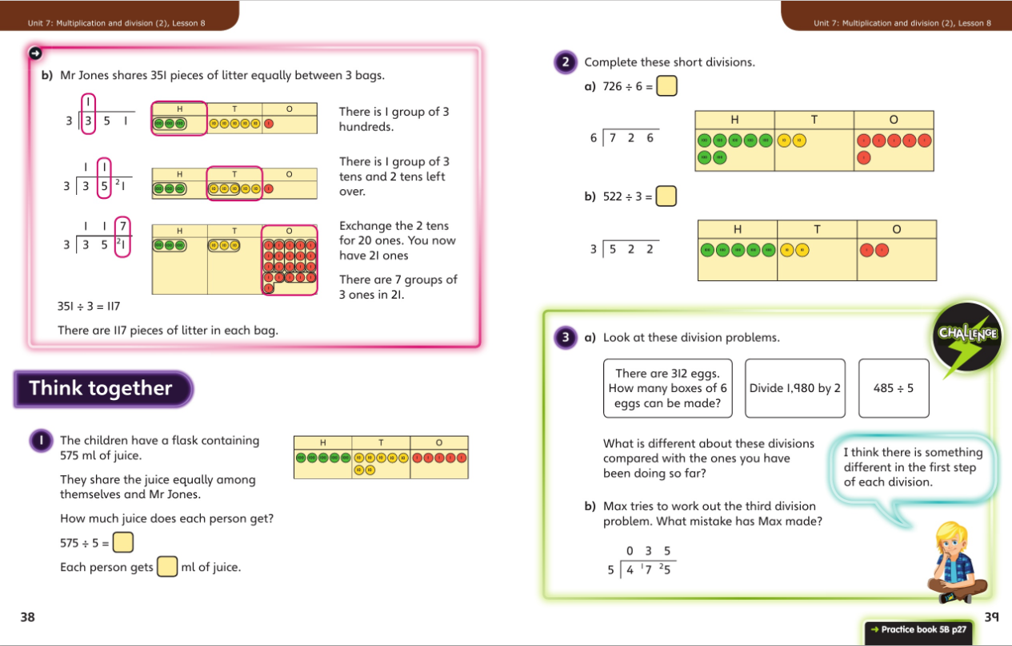
Think together
Friendly, supportive characters help children develop a growth mindset.
The scaffolding is gradually reduced as children become more familiar. Children are encouraged to talk together to explain how they solved the problems.
Notes:
In Think together, the scaffolding is gradually reduced as children become more familiar with the mathematical concept. We encourage children to talk together to explain how they solve the problems.
Throughout, maths language is used consistently to encourage all children to use the correct terms and feel comfortable with them.

Slide 10
Questions are presented in a logical sequence.
Practice
Calculations are connected so that children think about the underlying concepts.
Notes:
This is continued in the Practice Books, where each question varies one small element to move children on in their thinking.
Children complete intelligent practice independently, ending in a Reflect section where children reveal the depth of their understanding before moving on.

Slide 11
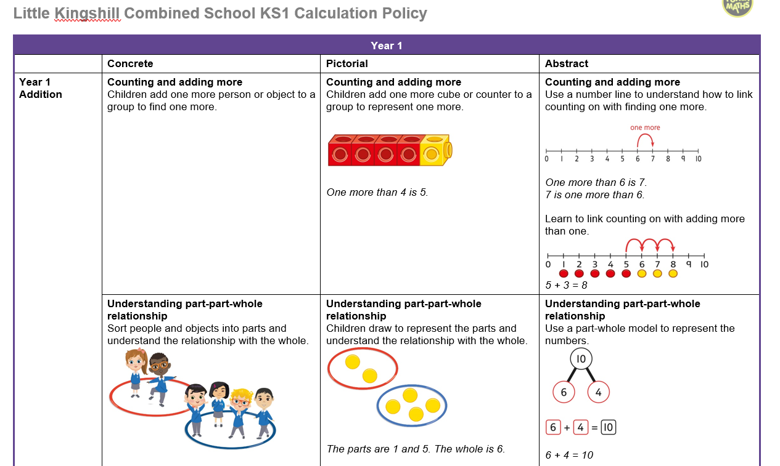

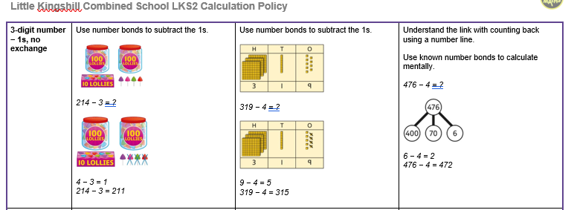
Models and representations
Helps show
the maths
problem as
a picture.
The full calculation policies can be found on our school website via these links:
Notes:
Children are encouraged to solve problems each day through the use of concrete resources, pictorial representations and abstract thinking (the C-P-A approach). This helps children tackle concepts in a tangible and more comfortable way.
C = Concrete. A familiar object that a child can manipulate to help bring the maths to life. Children make the connection between the number and the object. It could be cakes, cars or children!
P = Pictorial. This uses pictorial representations and diagrams of objects to ‘see’ what maths problems look like. This might be drawn counters which represent each child in the maths problem.
A = Abstract. The ultimate goal is for children to understand abstract mathematical concepts and symbols.

Slide 12
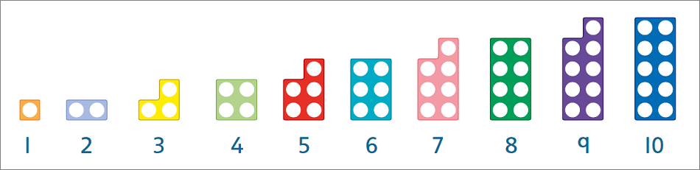
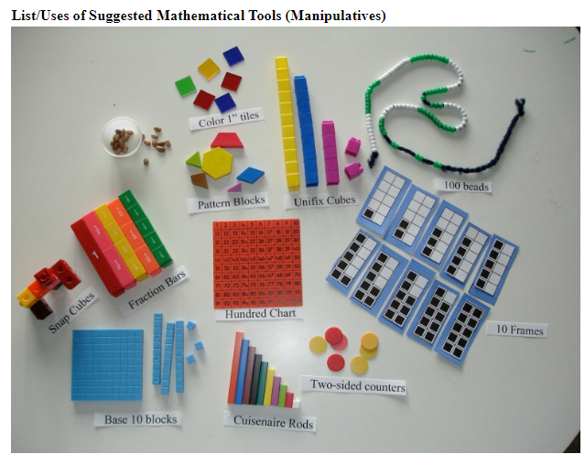
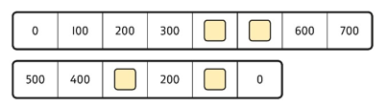
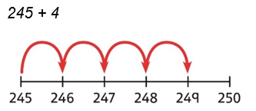
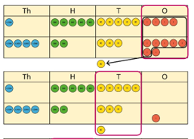
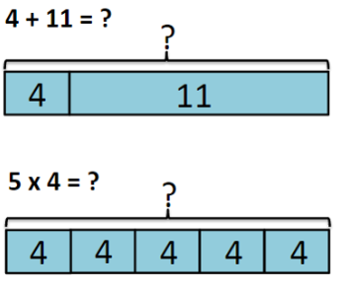
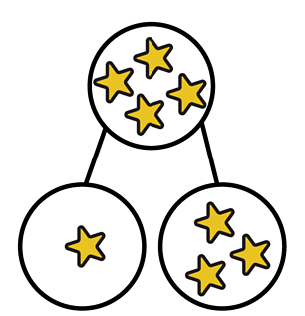
School models and representations
Numicon
Numberlines and number tracks
Place Value Columns
(also called Dienes)
Bar models
Part-whole models
7
3
Notes:
Children will be meeting mathematical models and representations which you might not yet be familiar with. Here are two examples: a part-whole model and a bar model.
These models help children to visualise the problem and explain their working.

Slide 13

Recall of key knowledge
Online platforms that help build key addition and subtraction or multiplication and division number facts in a fun way.
 | Year 1 | Year 2 | Year 3 | Year 4 | Year 5 | Year 6
Focus xtables- Expected knowledge by the end of that yeargroup | Count in multiples of 2, 5, 10 Doubles and halves to 10 | Multiplication and division facts for 2s, 5s and 10s | Multiplication and division facts for 3s, 4s and 8s | Multiplication and division facts for 6s, 9s | Confident recall of multiplication and division facts up to 12x12 | Review all timetables facts up to 12x12.
Autumn |  | Consolidate key recall facts from Year 1 | Weekly xtables and Mental Maths | Weekly xtables and Mental Maths | Weekly xtables and Mental Maths | Weekly xtables and Mental Maths
Spring | Making 10 and Addition facts within 10 Solve missing number problems within 10 | Weekly xtables and continued consolidating key facts if needed | Weekly xtables and Mental Maths | Weekly xtables and Mental Maths | Weekly xtables and Mental Maths | Weekly xtables and Mental Maths
Summer | Number bonds to make 20 Doubles, halves and counting in 2s, 5s and 10s | Weekly xtables and Mental Maths | Weekly xtables and Mental Maths | Weekly xtables and Mental Maths | Weekly xtables and Mental Maths | Weekly xtables and Mental Maths

Slide 14
How can you support your child at home?
Take an interest in their learning
Look on the Maths page for the Calculation Policies
Look on their Class Page for videos for their current Maths topic
Practise on Numbots and/or Times Tables Rock Stars
Real life Maths problems
Talk positively about Maths to develop their growth mindsets
Notes:
Children are encouraged to solve problems each day through the use of concrete resources, pictorial representations and abstract thinking (the C-P-A approach). This helps children tackle concepts in a tangible and more comfortable way.
C = Concrete. A familiar object that a child can manipulate to help bring the maths to life. Children make the connection between the number and the object. It could be cakes, cars or children!
P = Pictorial. This uses pictorial representations and diagrams of objects to ‘see’ what maths problems look like. This might be drawn counters which represent each child in the maths problem.
A = Abstract. The ultimate goal is for children to understand abstract mathematical concepts and symbols.

Slide 15

Any questions?
A0100

